Slide 1

Automated information extraction with Azure AI Document Intelligence.

Slide 2


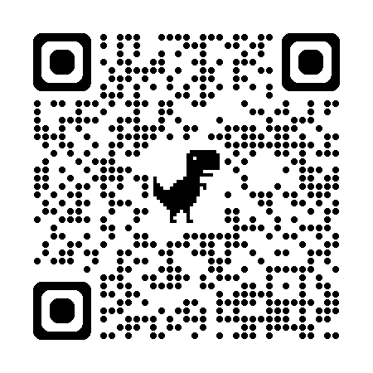

Microsoft MVP.
Client Partner at Geneca.
Spend time with family, movies, videogames, soccer.
Socials
Schedule time with me!

Slide 3
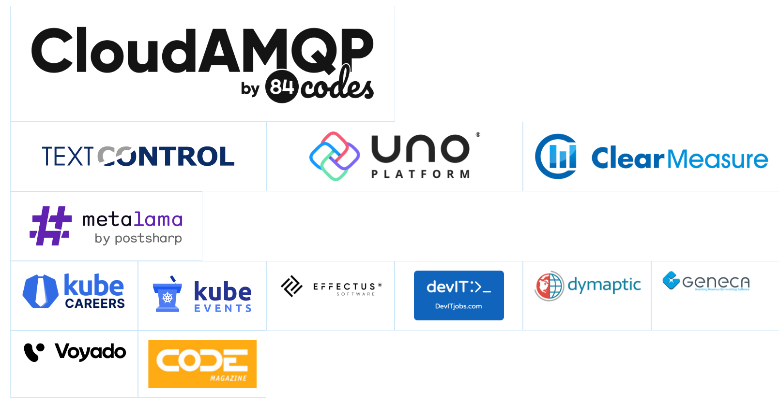
Thank You TechBash 2024 Sponsors!
Visit https://techbash.com/#Sponsors to visit our sponsors’ websites and learn more about them!

Slide 4
Agenda.
Azure AI ecosystem
Azure AI Document Intelligence
Model options
Input requirements
Data privacy
Demo
Document Intelligence Studio.
Web app.
RAG.
RAG

Slide 5
















Azure AI
Applications
Partner Solutions
Business Users
Application Platform
AI Builder
Power BI
Power Apps
Power Automate
Copilot Studio
Scenario-Based Services
Azure AI services
Bot Service
Azure AI Search
Document Intelligence
Video Indexer
Metrics Advisor
Immersive Reader
Customizable AI Models
Azure OpenAI
Service
Azure AI services
Vision
Speech
Language
Decision
Developers & Data Scientists
ML Platform
Azure Machine Learning

Slide 6
Model options.
Document analysis models.
Read
Layout
General document
Prebuilt models.
Custom models.

Slide 7

Document analysis models

Slide 8
Read model.
Extract text from documents (print and handwritten).
Detects paragraphs, text lines, words, locations and languages.
Higher resolution than Vision Read API.
Underlying OCR engine for other models.
Notes:
The Read model is the underlying OCR engine for other Document Intelligence prebuilt models like Layout, General Document, Invoice, Receipt, Identity (ID) document, Health insurance card, W2 in addition to custom models.

Slide 9
Read model development options.
Model | Resources | Model ID
Read model | Document Intelligence Studio REST API C# SDK Python SDK Java SDK JavaScript | prebuilt-read

Slide 10
Layout model.
Extract text and layout to return structured data representations.
Text roles in documents.
Geometric roles: Text, tables, and selection marks are examples of geometric roles.
Logical roles: Titles, headings, and footers are examples of logical roles.
Combines OCR with deep learning models.

Slide 11
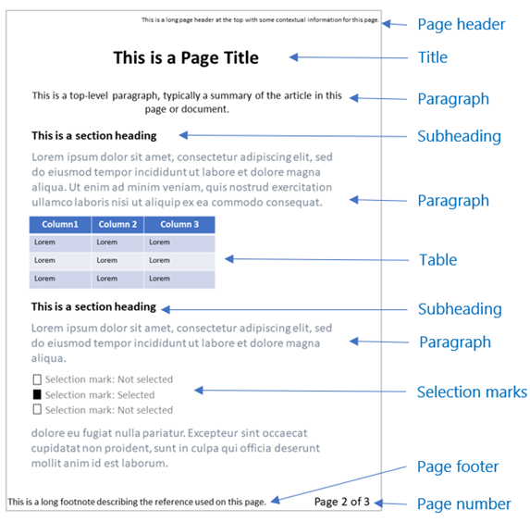

Slide 12
Layout model development options.
Feature | Resources | Model ID
Layout model | Document Intelligence Studio REST API C# SDK Python SDK Java SDK JavaScript SDK | prebuilt-layout

Slide 13
General document model.
Extract text, layout and key-value pairs from documents.
Pretrained model.
Supports structured, semi-structured and unstructured documents.
Notes:
General document can be used as an alternative to a custom model with labels

Slide 14
Key-value pairs
For structured document the label and value for a field.
For unstructured documents they are based on the text in the paragraph (like date in a contract).
Notes:
General document can be used as an alternative to a custom model with labels

Slide 15
General document model development options.
Feature | Resources | Model ID
General document model | Document Intelligence Studio REST API C# SDK Python SDK Java SDK JavaScript SDK | prebuilt-document

Slide 16
Prebuilt models

Slide 17
Available models.
Invoices.
US health insurance cards.
Receipts.
US personal tax*.
Identity documents.
US mortgage*.
US pay stubs*.
US bank statements*.
US checks*.

Slide 18
Available models.
Credit cards.
US marriage certificates.
Contracts.
Business cards.

Slide 19
Development options.
Feature | Resources | Model ID
Prebuilt models | Document Intelligence Studio REST API C# SDK Python SDK Java SDK* JavaScript SDK* | prebuilt-invoice prebuilt-receipt prebuilt-idDocument prebuilt-healthInsuranceCard.us prebuilt-tax.us.w2 prebuilt-contract prebuilt-businessCard prebuilt-tax.us.1098 prebuilt-tax.us.1098E prebuilt-tax.us.1098T
Notes:
*Receipt doesn’t have Java or Javascript SDKs

Slide 20
Custom models

Slide 21
Custom template.
Extract data from static layouts.
Capabilities.
Form fields.
Selection marks.
Tabular fields (tables).
Signature.
Selected regions.

Slide 22
Custom neural.
Extract data from mixed-type documents.
Supports structured, semi-structured and unstructured data.

Slide 23
Custom composed.
Extract data using a collection of models.
Notes:
General document can be used as an alternative to a custom model with labels

Slide 24
Classification model.
Identify document type before calling extraction model.

Slide 25
Input requirements.

Slide 26
File formats.
Model | PDF | Image (JPEG/JPG, PNG, BMP, and TIFF) | Microsoft Office: Word (DOCX), Excel (XLS), PowerPoint (PPT), and HTML
Read | Yes | Yes | Yes
Layout | Yes | Yes | No
General Document | Yes | Yes | No
Prebuilt | Yes | Yes | No
Custom | Yes | Yes | No

Slide 27
Model restrictions.
For PDF and TIFF, up to 2000 pages can be processed (2 for free tier).
File size less than 500 MB (4 MB for free tier).
Image dimensions must be between 50 x 50 pixels and 10,000 px x 10,000 pixels.

Slide 28
Model restrictions.
PDFs can’t be password protected.
Minimum size of text is 8-point text at 150 DPI.

Slide 29
Data privacy and security.
Authentication.
Data encrypted at rest and in transit.
Limited access features.
Data storage.
Request data not used to train APIs.
Containers.

Slide 30
Retrieval-Augmented Generation (RAG).
Design pattern that combines a pretrained LLM with an external data retrieval system.
Layout model with markdown output.
Semantic chunking.

Slide 31
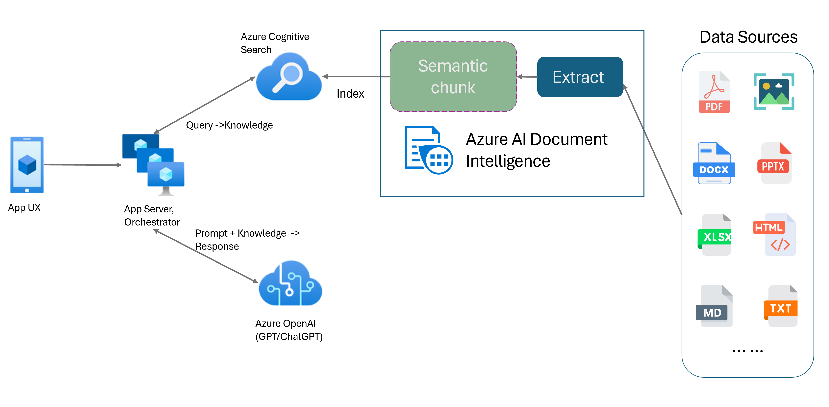
Retrieval-Augmented Generation (RAG).

Slide 32

DEMO

Slide 33
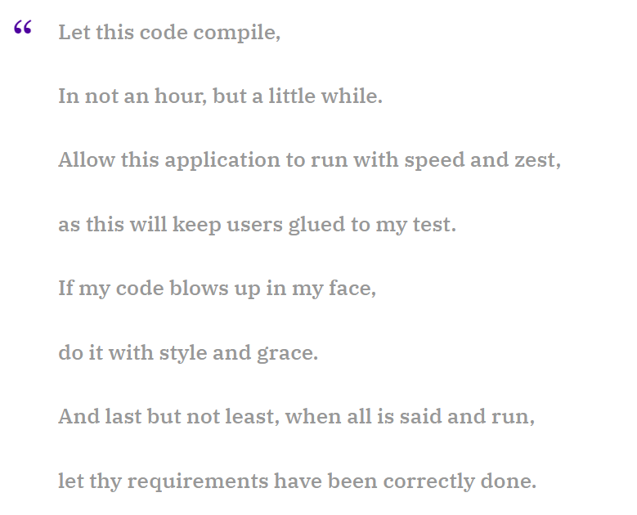
https://www.rambli.com/2016/06/the-prayer-of-the-demo-gods/

Slide 34
Questions?

Slide 35
Useful links.
https://learn.microsoft.com/en-us/azure/ai-services/document-intelligence/?view=doc-intel-3.1.0
https://learn.microsoft.com/en-us/legal/cognitive-services/document-intelligence/data-privacy-security
https://documentintelligence.ai.azure.com/studio

Slide 36
Useful links.
https://learn.microsoft.com/en-us/azure/ai-services/document-intelligence/concept-retrieval-augmented-generation?view=doc-intel-3.1.0

Slide 37
Socials
Schedule time with me!

